Slide 1
Used Cars Price Webscraping & Prediction
In this task we need to create dataset of used cars price using webscraping & then we need to perform EDA & model building to observe which factor is affecting the prices of used cars & how much that factor is affecting the price.

Slide 2
Steps taken before EDA was performed
Created the dataset using webscraping.
Imported necessary libraries for task to be completed.
Loaded dataset on jupyter notebook using pandas library.
Cleaned the target variable & make it refined to make prediction on.
Checked the dimensions of the dataset which was showing that dataset contains 5047 rows & 8 columns.
Checked description of dataset which gives information of mean, min value, max value, etc of every column in dataset which contains continuous data in it.
Checked the presence of null values in the datset & null values were present in it.

Slide 3
Exploratory Data Analysis

Slide 4
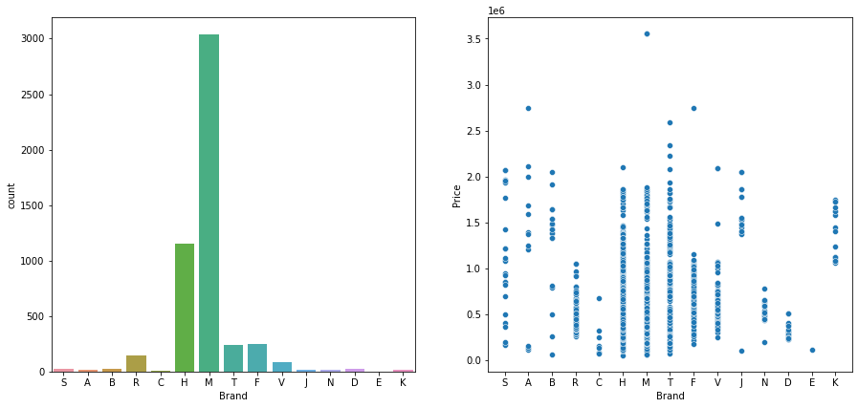
1. Brand
Checked unique values of the column.
Filled null values randomly to avoid data bias.
From visualization we concluded that most cars available for sale is of Brand name starting with M & least sale of used car is from Brand name starting with E.

Slide 5
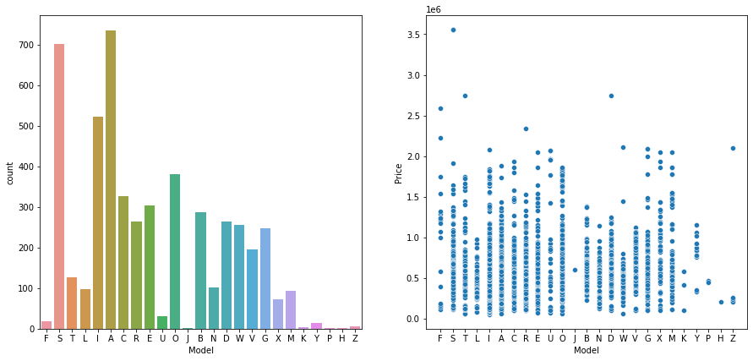
2. Model
Checked unique values of the column.
Filled null values randomly to avoid data bias.
From visualization we concluded that most cars available for sale is of Model name starting with A & least cars available for sale is of Model name starting with H. Also the highest price for a car is of model name starting with S.

Slide 6
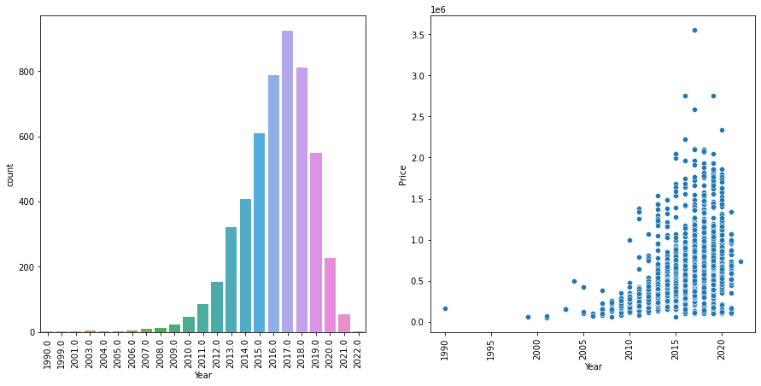
3. Year
Checked unique values of the column.
Filled null values randomly to avoid data bias.
From visualization we concluded that most cars available for sale are manufactured in year 2017 & cars available for sale that were manufactured before year 2000 are very few & highest price for the car for sale is from year 2017.

Slide 7
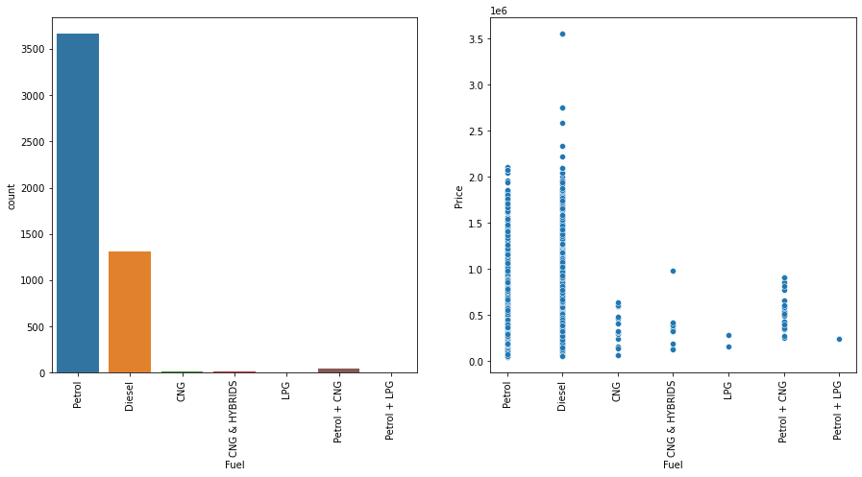
4. Fuel
Checked unique values of the column.
Filled null values randomly to avoid data bias.
From visualization we concluded that most cars for sale use petrol as fuel & least cars available for sale use petrol + LPG as fuel. Also the highest price for a car available for sale use diesel as fuel.

Slide 8
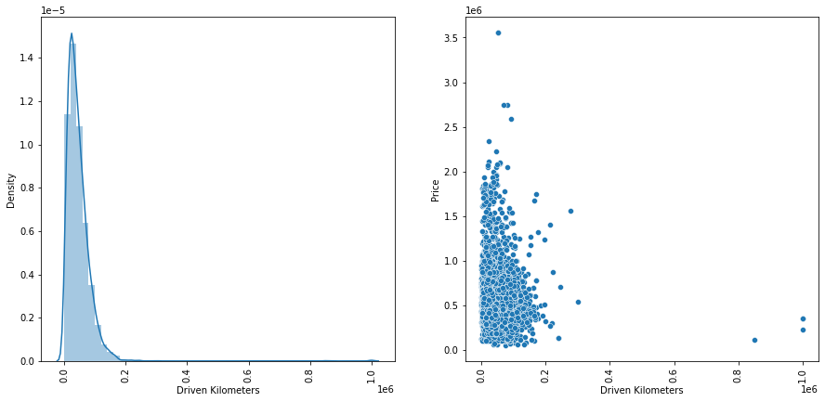
5. Driven Kilometers
Checked unique values of the column.
Filled null values randomly to avoid data bias.
From visualization we concluded that data is positively skewed with having highest density at around 0.05 & most cars available for sale are concentrated with in range from 0.0 to 0.2

Slide 9
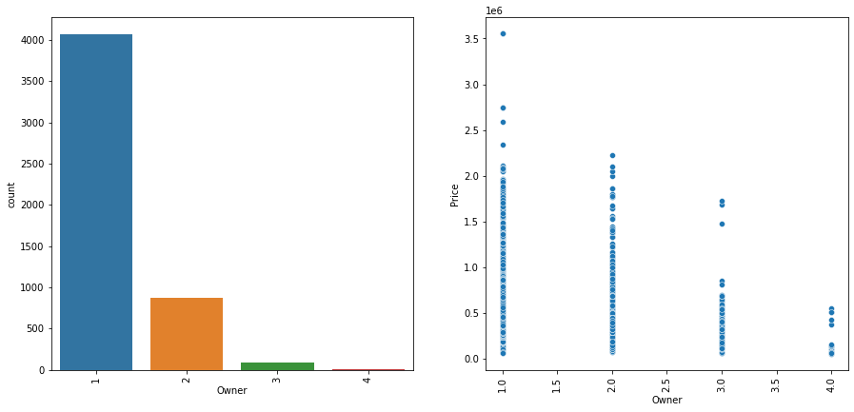
6. Owner
Checked unique values of the column.
Filled null values randomly to avoid data bias.
From visualization we concluded that most cars available for sale have 1st owner & least cars available for sale have 4th owner.

Slide 10
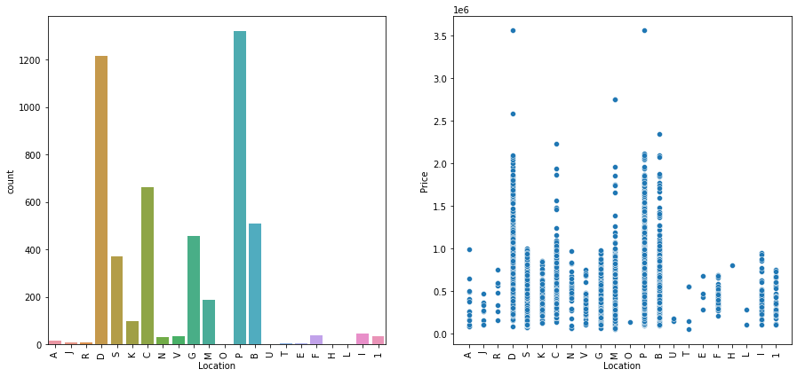
7. Location
Checked unique values of the column.
Filled null values randomly to avoid data bias.
From visualization we concluded that most cars available for sale are from location name starting with P & least cars available for sale are from location name starting with H.

Slide 11
Plotting Heatmap
Plotted Heatmap to check correlation of every column with target column.
We concluded that target column has high positive correlation with following ( Model, Year & Fuel) columns
After observing all the columns we decided to drop Brand column to lower the multi-collinearity.

Slide 12
Splitting & scaling data
Splitted the original dataset into X & y in which y contains target column & X contains other columns.
Then we splitted the X & y data into training set & testing set.
Then we scaled both X_train & X_test set using Standard scalar to remove outliiers if present in dataset.

Slide 13
Applying GridSearchCV
We chose 4 regression models (Linear Regression Model, Decision Tree Regression Model, Random Forest Regression Model & Bagging Regression Model) to check performance of them on the dataset to find out the best suited model for the dataset.
Then one by one we applied GridSearchCV on each model to find best hyper parameter tuning while model is working on the dataset.
After applying GridSearchCV on every model we concluded that out of all models Random Forest Regression Model is giving the best test r2_score for dataset which is 0.3414 with hyper parameter combination (max_depth : 5, min_samples_leaf : 1, min_samples_split : 5)

Slide 14
Applying Model on dataset
Chose Random Forest Regression Model & made it ready by tuning hyper parameter.
After tuning hyper parameter applied model on dataset to make prediction.
After making prediction we made the dataframe showing predicted values & actual values.
Then we applied various metrices on model to check its performance which were r2_score, mean squared error score, mean absolute error score.
After looking the scores of every metrices we concluded that model is performing quite okay on dataset.
After making the conclusion we saved the model using pickle library.

Slide 15
THE END

